Slide 1
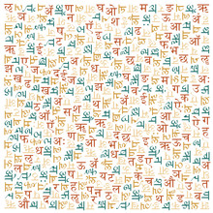
Handwritten Devanagari Script Recognition Using Convolutional Neural Networks (CNNs)

Slide 2
Team Members
Jyotesh Lagishetty
Pallavi Bongu
Kalkesh Gembali
Keerthi Balabhadruni

Slide 3
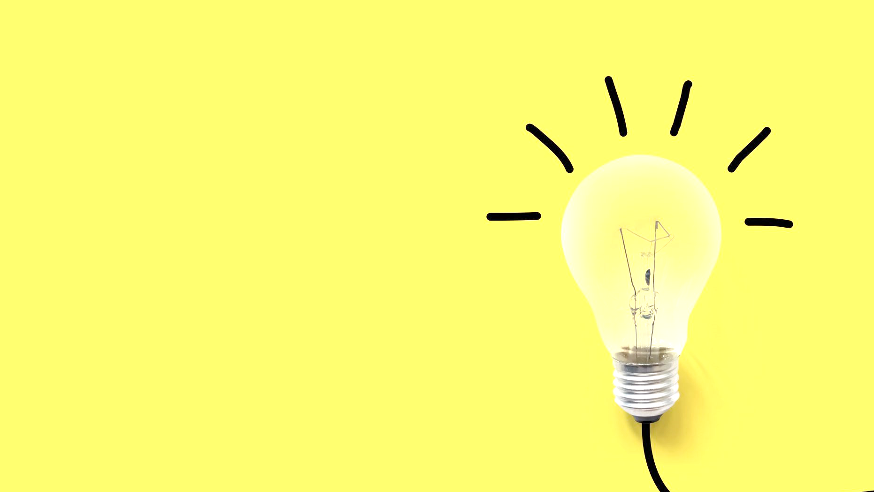
Statement of Project Objectives
Devanagari is the primary writing system for Hindi, Marathi, Nepali, and Sanskrit languages. The model is trained on a dataset of 46 classes, with 2000 images per class.
The objective of this project is to develop a robust and accurate system for recognizing handwritten Devanagari characters using Convolutional Neural Networks (CNNs). The system aims to achieve the following objectives:
Develop a dataset of handwritten Devanagari characters for training and testing the CNN model.
Preprocess the dataset to enhance the quality of the images and prepare them for training.
Design and implement a CNN architecture suitable for recognizing Devanagari characters.
the CNN model using the prepared dataset to achieve high accuracy in character recognition.
Evaluate the trained model on a separate test dataset to measure its performance in terms of accuracy and efficiency.
Fine-tune the model and optimize its hyperparameters to improve performance.
Compare the performance of the CNN model with existing methods for Devanagari character recognition.
Document the process, results, and findings of the project in a comprehensive report.
Provide recommendations for future enhancements and applications of the developed system.

Slide 4

Statement of Value
Benefits a Large Population:Devanagari is used by over 1 billion people globally. This project has the potential to improve processing and understanding of handwritten Devanagari text.
Improves Accessibility:Processing handwritten Devanagari documents can be challenging. This project offers solutions for tasks like automatic document indexing, data entry, and historical document archiving.
Promotes Language Preservation:By facilitating digitization and analysis of handwritten documents, this project can aid in preserving cultural heritage and historical records
Advances AI and NLP:This project contributes to developing more robust AI and NLP techniques for handling handwritten Devanagari script, leading to advancements in machine translation and document processing.
Practical Applications:The deployed Flask application can be used in various scenarios. It could be integrated into mobile apps for real-time character recognition, educational tools, or assistive technologies.

Slide 5

Review of the State of the Art and Relevant Works
Traditional methods relied on handcrafted features and machine learning algorithms (SVMs, KNNs).
CNNs have become the state-of-the-art due to their ability to learn features automatically
A Review on Hand Return Devanagari Character Recognition:Surveys various techniques, highlights the shift towards deep learning approaches. Reports on CNN architectures achieving over 90% accuracy.
Hand Return Devanagari Character Recognition Using DeepLearning: Investigates a deep CNN architecture with high accuracy (96.09%).
Review for Hand Return Devanagari Character Recognition Using ML Algorithm:Emphasizes pre-processing for improved accuracy. Mentions pre-trained models and transfer learning achieving high accuracy.
EasyChair Preprint: Discusses CNN architectures for Devanagari recognition. Highlights studies achieving over 99% accuracy using pre-trained models and transfer learning.

Slide 6

Approach
Utilize a publicly available dataset of labeled Devanagari characters.
The dataset should contain a sufficient number of images for each character class to ensure effective training.
Algorithms: Convolutional Neural Networks (CNNs).
Design a custom CNN architecture with convolutional layers for feature extraction, pooling layers for dimensionality reduction, and fully connected layers for classification.
The specific architecture will be chosen based on the complexity of the dataset and computational resources available.
Training Process: Preprocess the data by resizing images, normalizing pixel values, and potentially applying data augmentation techniques.
Train the CNN model on the preprocessed data using an appropriate optimizer (e.g., Adam) and loss function (e.g., categorical cross-entropy).
Monitor the training process using validation data to prevent overfitting.

Slide 7

Deliverables
Core deliverable will be the Python code encompassing all stages of the project.
This code will be well-structured, documented, and include comments to enhance readability and understanding.
Key Components of the code will include: Components of the code will include:
Data preprocessing functions for tasks like image resizing and normalization.
The CNN model definition, specifying the architecture with its layers and parameters.
The training script, outlining the training process with the chosen optimizer, loss function, and hyperparameter settings.
Evaluation scripts for calculating performance metrics on the test set.
Flask application code for deploying the trained model in a web application.

Slide 8
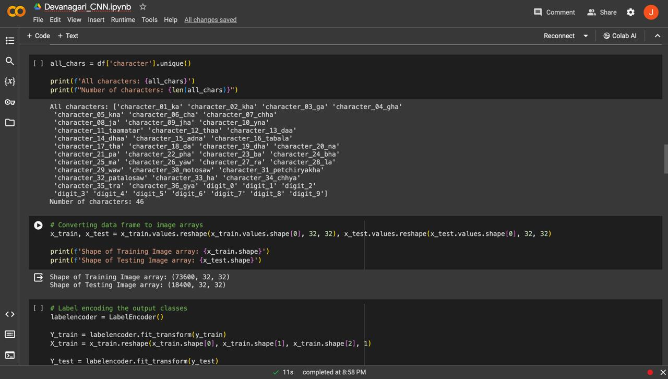
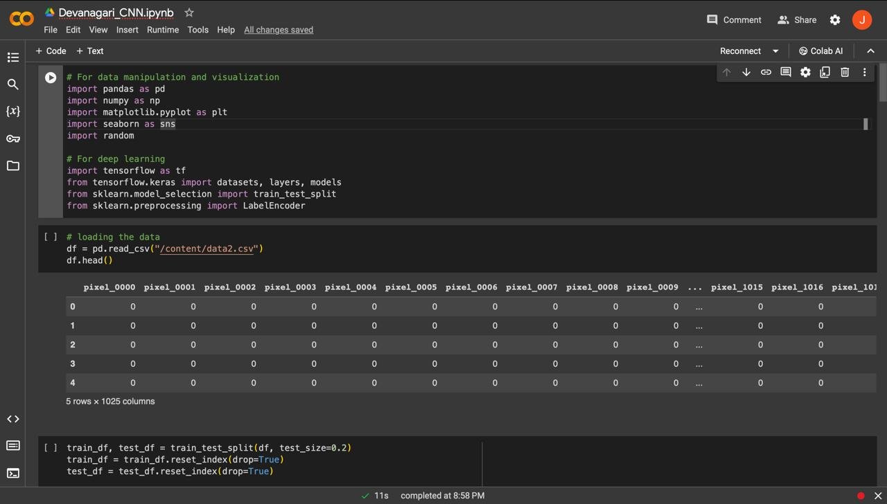
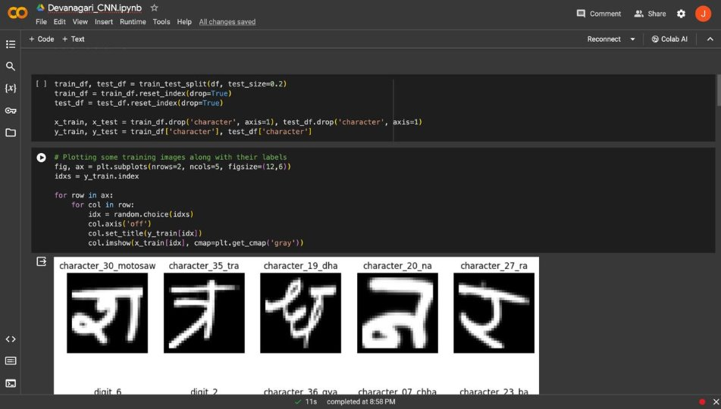
Code

Slide 9
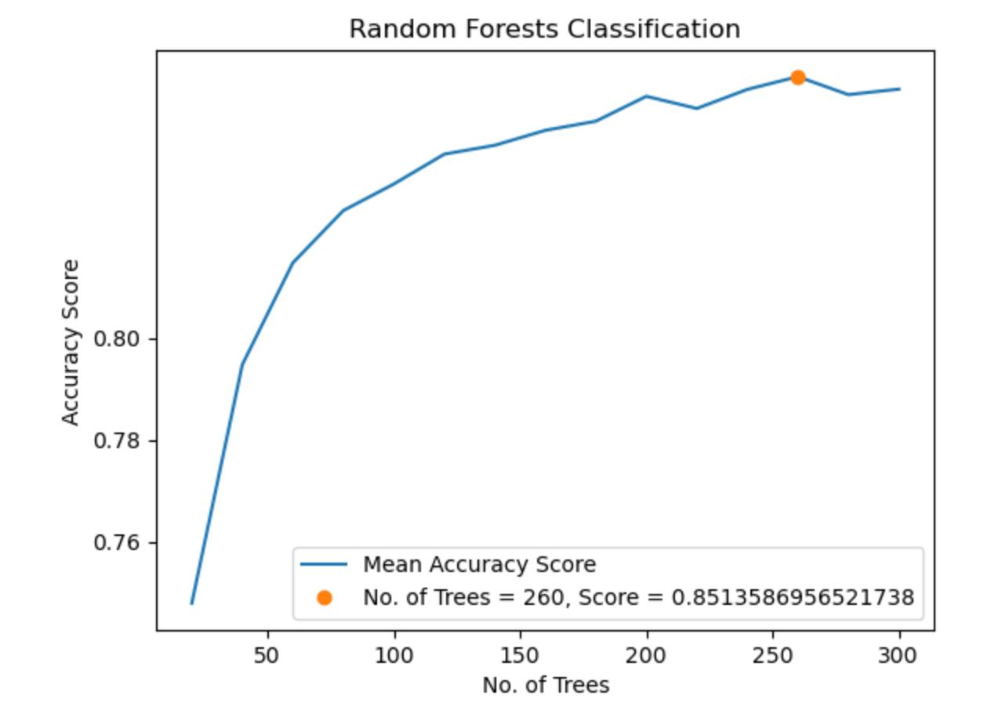
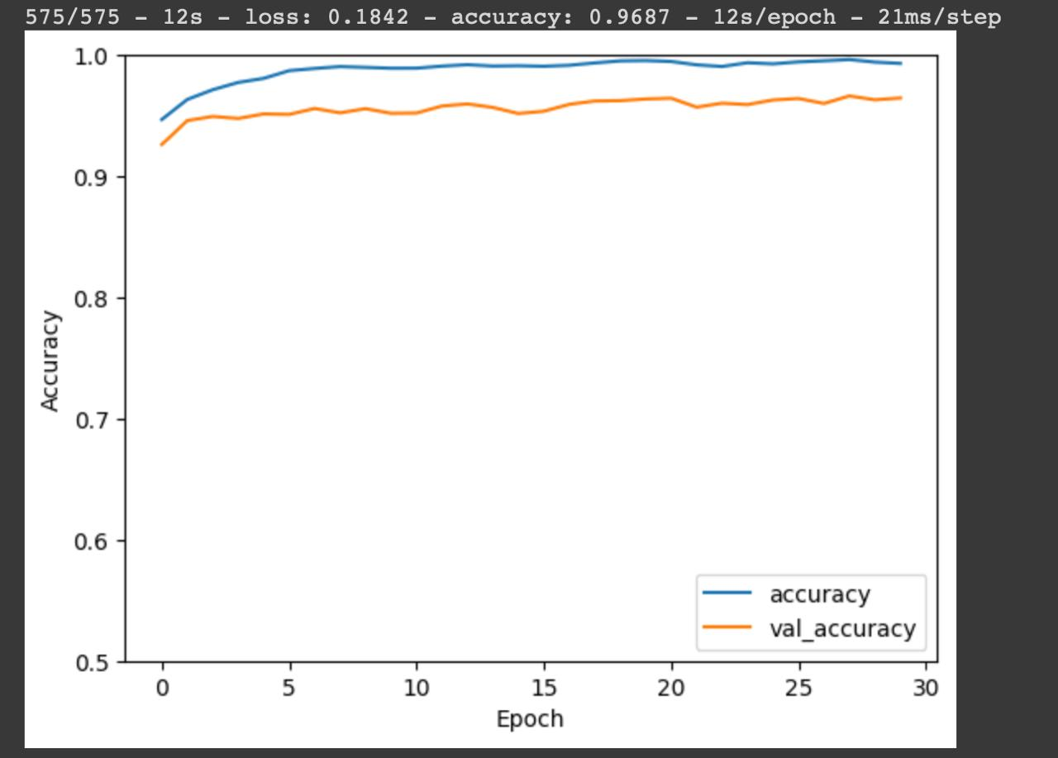
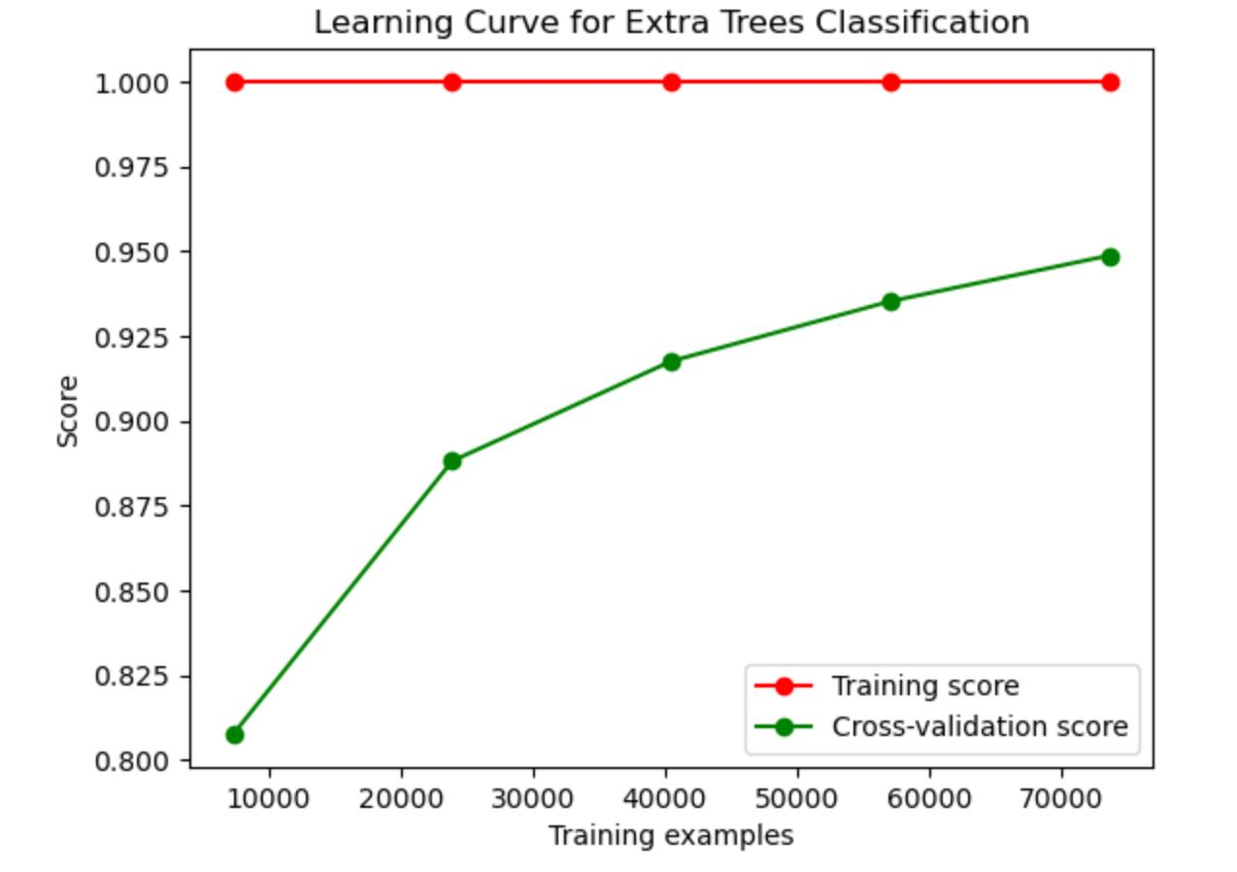
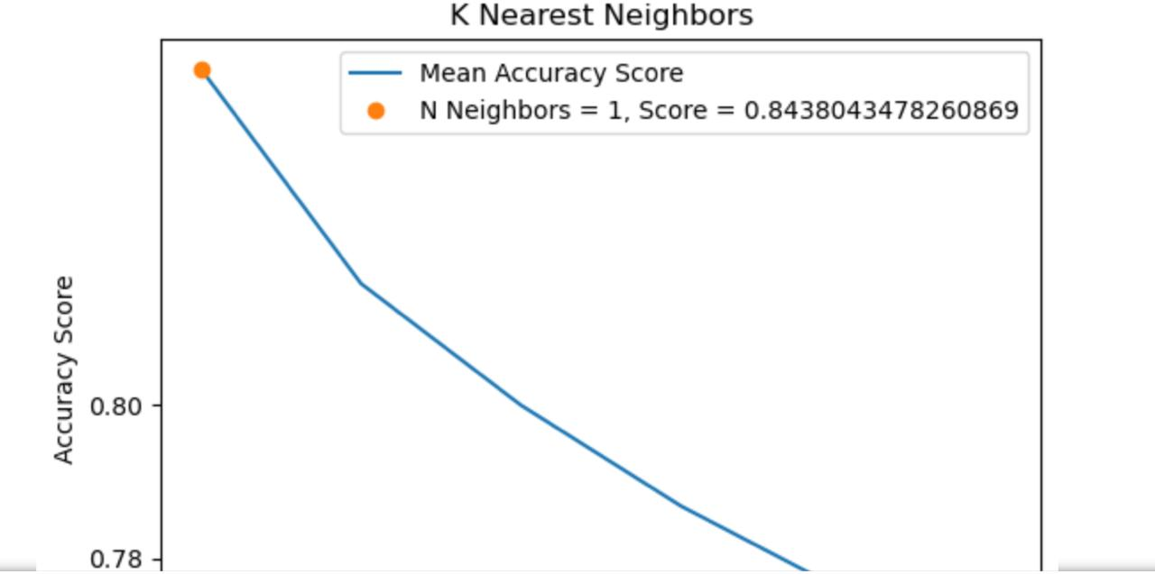
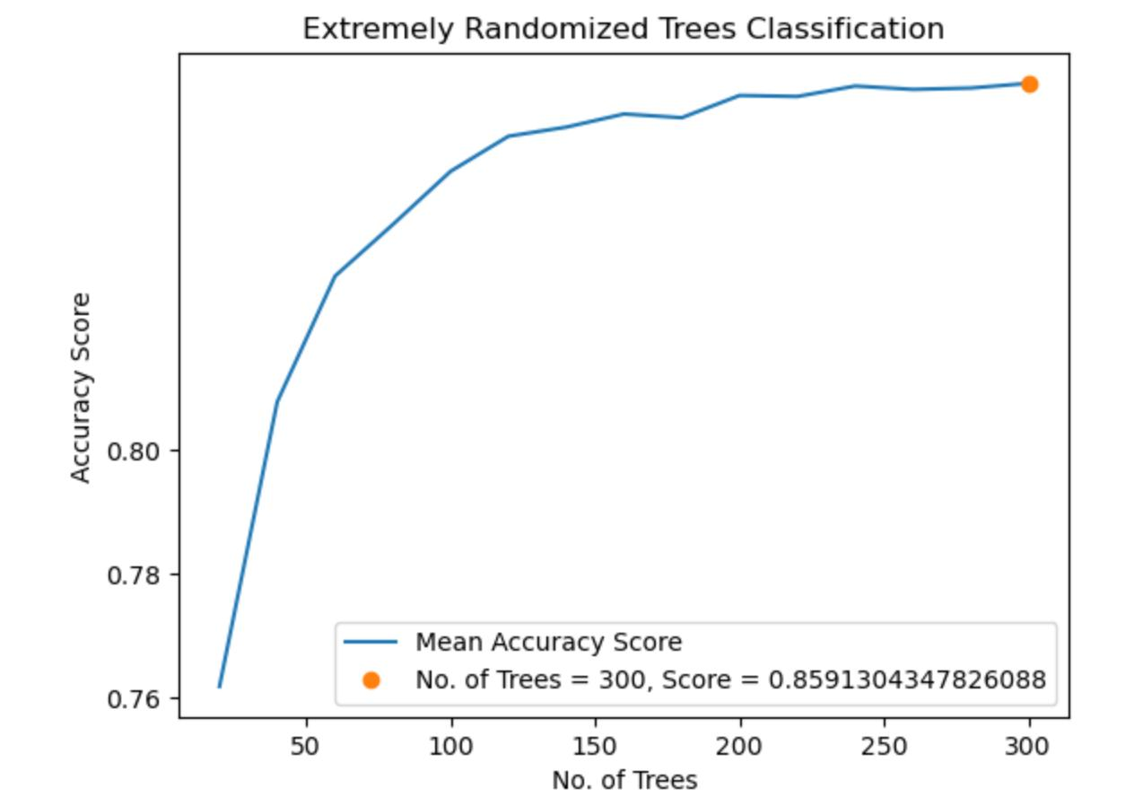
Results

Slide 10
Evaluation Methodology
Evaluation Metrics:
Accuracy: The overall percentage of characters correctly classified by the model.
Precision: Measures the proportion of predicted positive cases that are truly positive. (True Positive / (True Positive + False Positive))
Recall: Measures the proportion of actual positive cases that are correctly identified. (True Positive / (True Positive + False Negative))
Confusion Matrix: A visual representation of the model's performance on each character class. It provides insights into classification errors and areas for potential improvement.
Evaluation Process:
Held-Out Test Set: The model's performance will be evaluated on a separate test set not used during training. This ensures an unbiased assessment of the model's generalization ability to unseen data.
Training-Validation Split: Alternatively, the training data might be split into training and validation sets.
- The model is trained on the training set and evaluated on the validation set to monitor for overfitting.
- Overfitting occurs when the model memorizes the training data peculiarities and performs poorly on
unseen data.

Slide 11
Conclusion
Achieving Accuracy through CNNs: The utilization of Convolutional Neural Networks (CNNs) has demonstrated remarkable potential in recognizing handwritten Devanagari script accurately.
Robust Performance: Our study has revealed the robustness of CNN-based models in handling the complexities inherent in handwritten Devanagari characters, yielding promising results across various datasets.
Enhancing Accessibility: By developing reliable recognition systems, we contribute to enhancing accessibility for Devanagari script users, facilitating seamless integration into digital platforms and technologies.
Towards Practical Applications: With the foundation laid by this study, the prospects for real-world applications such as OCR systems, language translation, and digital archiving of Devanagari texts are increasingly within reach.

Slide 12

.

